Slide 1
Chapter 14: Indexing

Slide 2
Outline
Basic Concepts
Ordered Indices
B⁺-Tree Index Files
B-Tree Index Files
Hashing
Spatio-Temporal Indexing
Notes:
53

Slide 3
Basic Concepts
Indexing mechanisms used to speed up access to desired data.
E.g., author catalog in library
Search Key - attribute to set of attributes used to look up records in a file.(book-author,subject,title)
An index file consists of records (called index entries) of the form
Index files are typically much smaller than the original file
Two basic kinds of indices:
Ordered indices: search keys are stored in sorted order
Hash indices: search keys are distributed uniformly across “buckets” using a “hash function”.
search-key
pointer

Slide 4
Index Evaluation Metrics
Several techniques for ordered indexing
Access types supported efficiently. E.g.,
Records with a specified value in the attribute
Records with an attribute value falling in a specified range of values.
Techniques depend on db application
Access time –find item
Insertion time - find correct place+update the index structure
Deletion time -find item time+update index structure
Space overhead –additional space occupied by index structure

Slide 5
Ordered Indices
In an ordered index, index entries are stored sorted on the search key value.
Clustering index: in a sequentially ordered file, the index whose search key specifies the sequential order of the file.
Also called primary index
The search key of a primary index is usually but not necessarily the primary key.
Secondary index: an index whose search key specifies an order different from the sequential order of the file. Also called nonclustering index.
Index-sequential file: sequential file ordered on a search key, with a clustering index on the search key.

Slide 6
Dense Index Files(ordered index)
Dense index — Index record appears for every search-key value in the file.
E.g. index on ID attribute of instructor relation

Slide 7
Dense Index Files (Cont.)
Dense index on dept_name, with instructor file sorted on dept_name dense-clustering index

Slide 8
Sparse Index Files
Sparse Index: contains index records for only some search-key values.
Applicable when records are sequentially ordered on search-key
To locate a record with search-key value K we:
Find index record with largest search-key value < K
Search file sequentially starting at the record to which the index record points -dictonary word at top of the each page

Slide 9
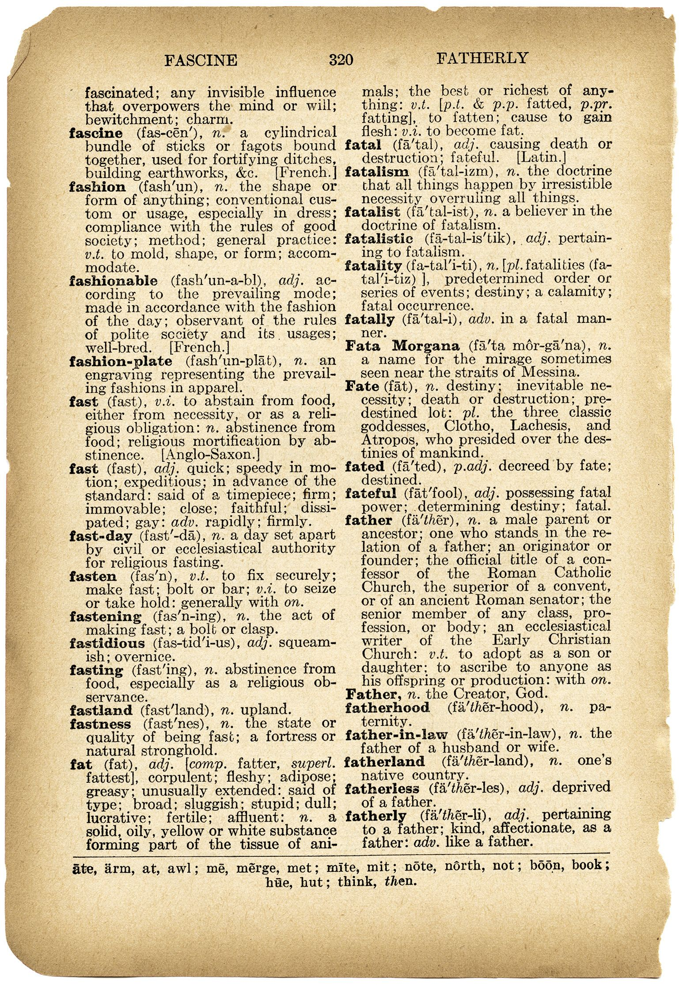

dictonary word
at top of the each page
-sparse index

Slide 10
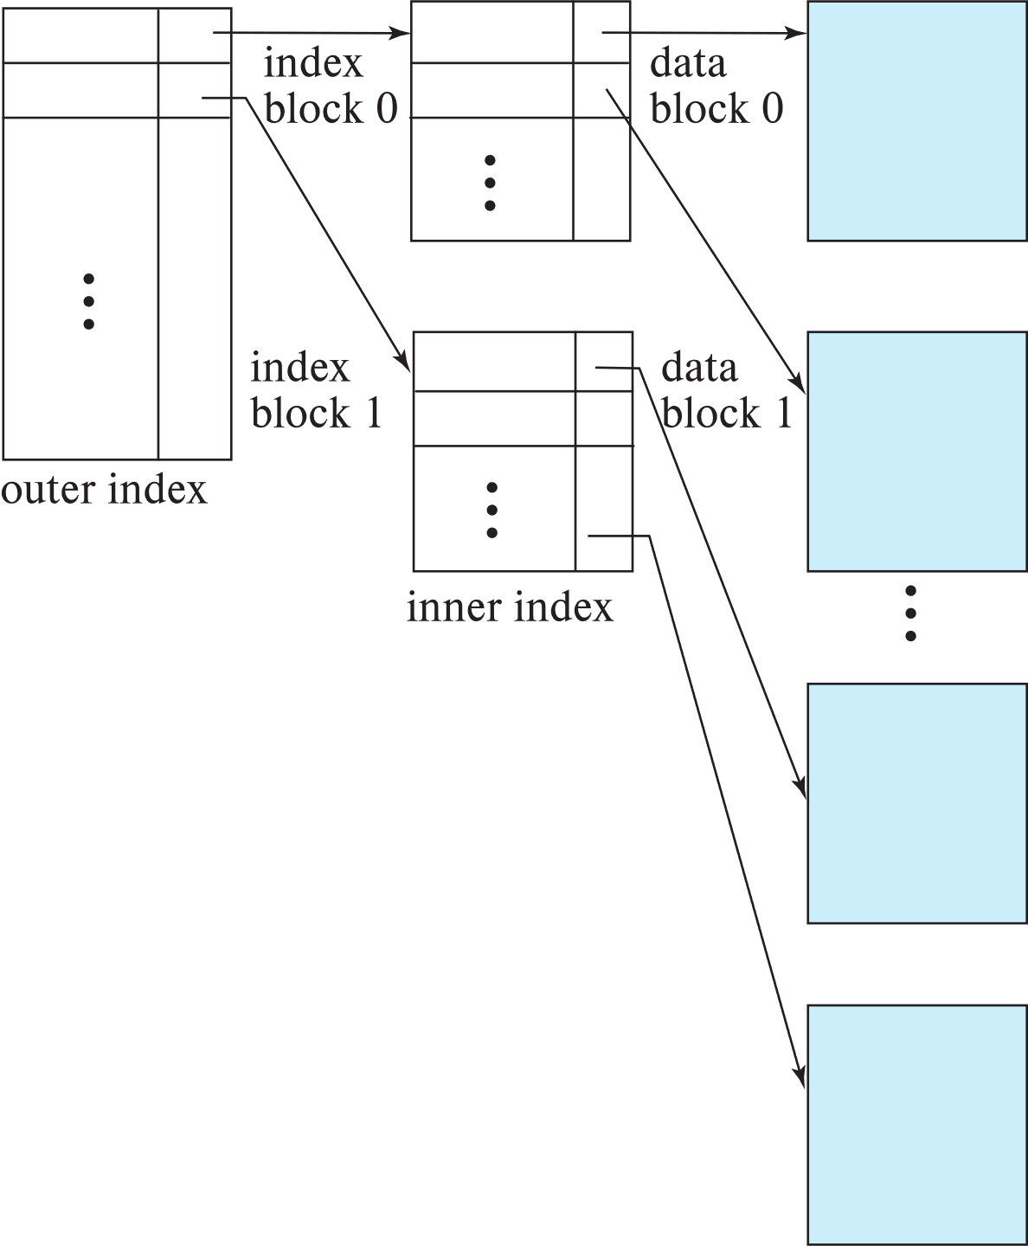
Sparse Index Files (Cont.)
Compared to dense indices:
Less space and less maintenance overhead for insertions and deletions.
Generally slower than dense index for locating records.-access time
Good tradeoff:
for clustered index: sparse index with an index entry for every block in file, corresponding to least search-key value in the block.
For unclustered index: sparse index on top of dense index (multilevel index)
access time and space overhead ???
Notes:
Include fig 14.5

Slide 11
Secondary Indices Example
Secondary index on salary field of instructor
Index record points to a bucket that contains pointers to all the actual records with that particular search-key value.
Secondary indices have to be dense
Notes:
Pg 629 log calculation-
Dept. name

Slide 12
Clustering vs Nonclustering Indices
Indices offer substantial benefits when searching for records.
BUT: indices imposes overhead on database modification
when a record is inserted or deleted, every index on the relation must be updated
When a record is updated, any index on an updated attribute must be updated
Sequential scan using clustering index is efficient, but a sequential scan using a secondary (nonclustering) index is expensive on magnetic disk
Each record access may fetch a new block from disk
Each block fetch on magnetic disk requires about 5 to 10 milliseconds

Slide 13
Multilevel Index
If index does not fit in memory, access becomes expensive.
Solution: treat index kept on disk as a sequential file and construct a sparse index on it.
outer index – a sparse index of the basic index
inner index – the basic index file
If even outer index is too large to fit in main memory, yet another level of index can be created, and so on.
Indices at all levels must be updated on insertion or deletion from the file.

Slide 14
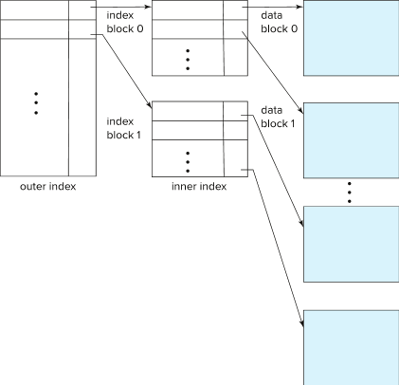
Multilevel Index (Cont.)

Slide 15
Index Update: Deletion
If deleted record was the only record in the file with its particular search-key value, the search-key is deleted from the index also.
Single-level index entry deletion:
Dense indices – deletion of search-key is similar to file record deletion.
Sparse indices –
if an entry for the search key exists in the index, it is deleted by replacing the entry in the index with the next search-key value in the file (in search-key order).
If the next search-key value already has an index entry, the entry is deleted instead of being replaced.
Notes:
Id dept_name of instructor changed, an index on dept. name must update.

Slide 16
Index Update: Insertion
Single-level index insertion:
Perform a lookup using the search-key value of the record to be inserted.
Dense indices – if the search-key value does not appear in the index, insert it
Indices are maintained as sequential files
Need to create space for new entry, overflow blocks may be required
Sparse indices – if index stores an entry for each block of the file, no change needs to be made to the index unless a new block is created.
If a new block is created, the first search-key value appearing in the new block is inserted into the index.
Multilevel insertion and deletion: algorithms are simple extensions of the single-level algorithms

Slide 17
Indices on Multiple Keys
Composite search key - A search-key containing more than one attribute
E.g., index on instructor relation on attributes (name, ID)
Values are sorted lexicographically
E.g. (John, 12121) < (John, 13514) and (John, 13514) < (Peter, 11223)
Can query on just name, or on (name, ID)
Take(course_id,semester,year)
find all students registered for a course in a particular semester.
Notes:
A search-key containing more than one attribute -compo search key
Take(course_id,semester,year)

Slide 18
B⁺-Tree Index Files
Disadvantage of indexed-sequential files
Performance degrades as file grows, since many overflow blocks get created.
Periodic reorganization of entire file is required.
Advantage of B⁺-tree index files:
Automatically reorganizes itself with small, local, changes, in the face of insertions and deletions.
Reorganization of entire file is not required to maintain performance.
(Minor) disadvantage of B⁺-trees:
Extra insertion and deletion overhead, space overhead.
Advantages of B⁺-trees outweigh disadvantages
B⁺-trees are used extensively

Slide 19
Example of B⁺-Tree
Notes:
Balanced tree length from leaf to root is same.

Slide 20
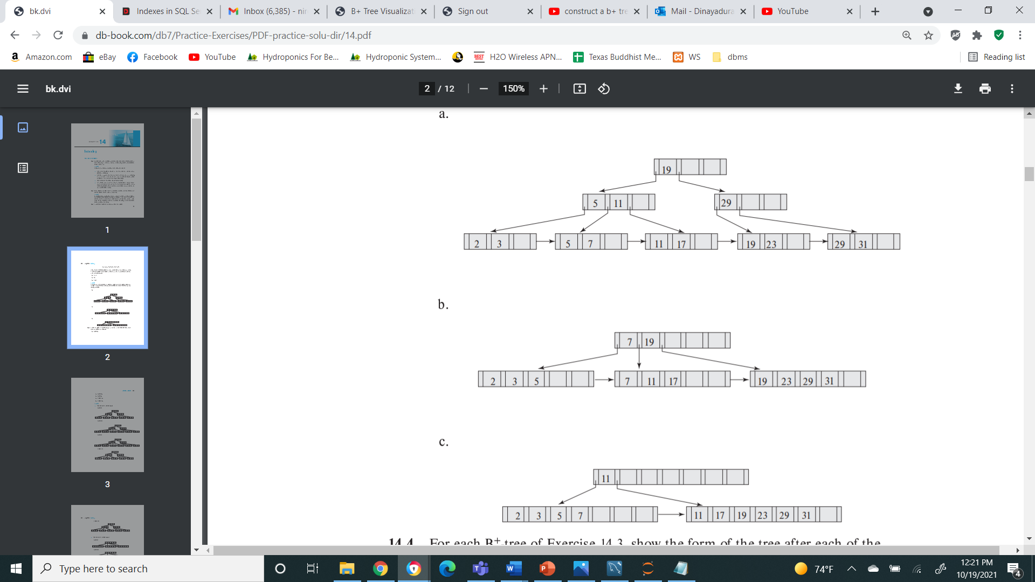
B⁺-Tree Index Files (Cont.)
A B⁺-tree is a rooted tree satisfying the following properties:
All paths from root to leaf are of the same length
Each node that is not a root or a leaf has between ⎡n/2⎤ and n children.
A leaf node has between ⎡(n–1)/2⎤ and n–1 values
Special cases:
If the root is not a leaf, it has at least 2 children.
If the root is a leaf (that is, there are no other nodes in the tree), it can have between 0 and (n–1) values.

Slide 21
B⁺-Tree Node Structure
Typical node
K_{i} are the search-key values
P_{i} are pointers to children (for non-leaf nodes) or pointers to records or buckets of records (for leaf nodes).
The search-keys in a node are ordered
K₁ < K₂ < K₃ < . . . < K_{n–1}
(Initially assume no duplicate keys, address duplicates later)

Slide 22
Leaf Nodes in B⁺-Trees
Properties of a leaf node:
For i = 1, 2, . . ., n–1, pointer P_{i} points to a file record with search-key value K_{i},
If L_{i}, L_{j} are leaf nodes and i < j, L_{i}’s search-key values are less than or equal to L_{j}’s search-key values
P_{n} points to next leaf node in search-key order

Slide 23
Non-Leaf Nodes in B⁺-Trees
Non leaf nodes form a multi-level sparse index on the leaf nodes. For a non-leaf node with m pointers:
All the search-keys in the subtree to which P₁ points are less than K₁
For 2 ≤ i ≤ n – 1, all the search-keys in the subtree to which P_{i} points have values greater than or equal to K_{i–1} and less than K_{i}
All the search-keys in the subtree to which P_{n} points have values greater than or equal to K_{n–1}
General structure

Slide 24
Example of B⁺-tree
B⁺-tree for instructor file (n = 6)
Leaf nodes must have between 3 and 5 values (⎡(n–1)/2⎤ and n –1, with n = 6).
Non-leaf nodes other than root must have between 3 and 6 children (⎡(n/2⎤ and n with n =6).
Root must have at least 2 children.

Slide 25

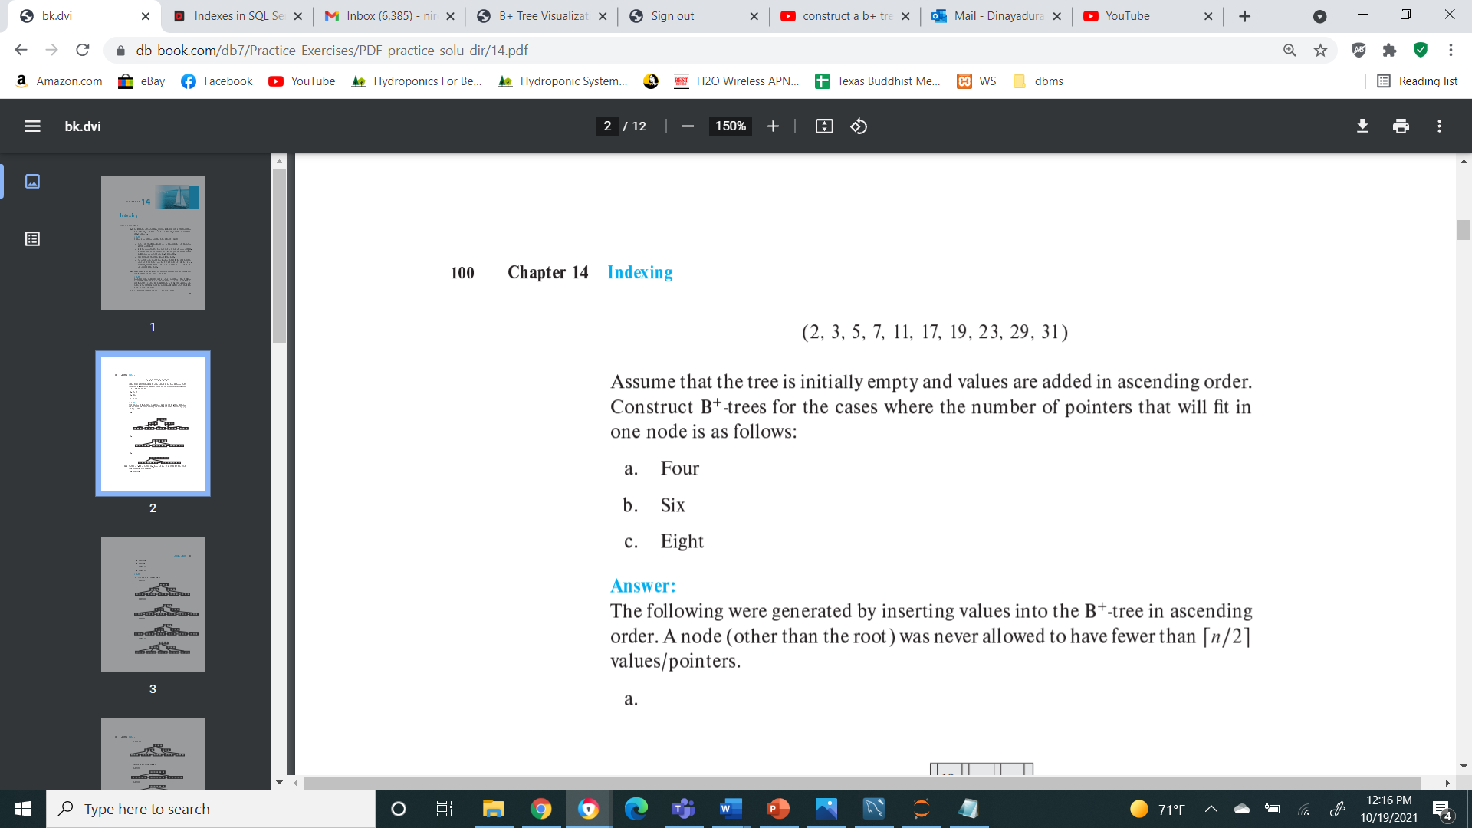
Notes:
2,3,5,7,11,17,19,23,29,31

Slide 26
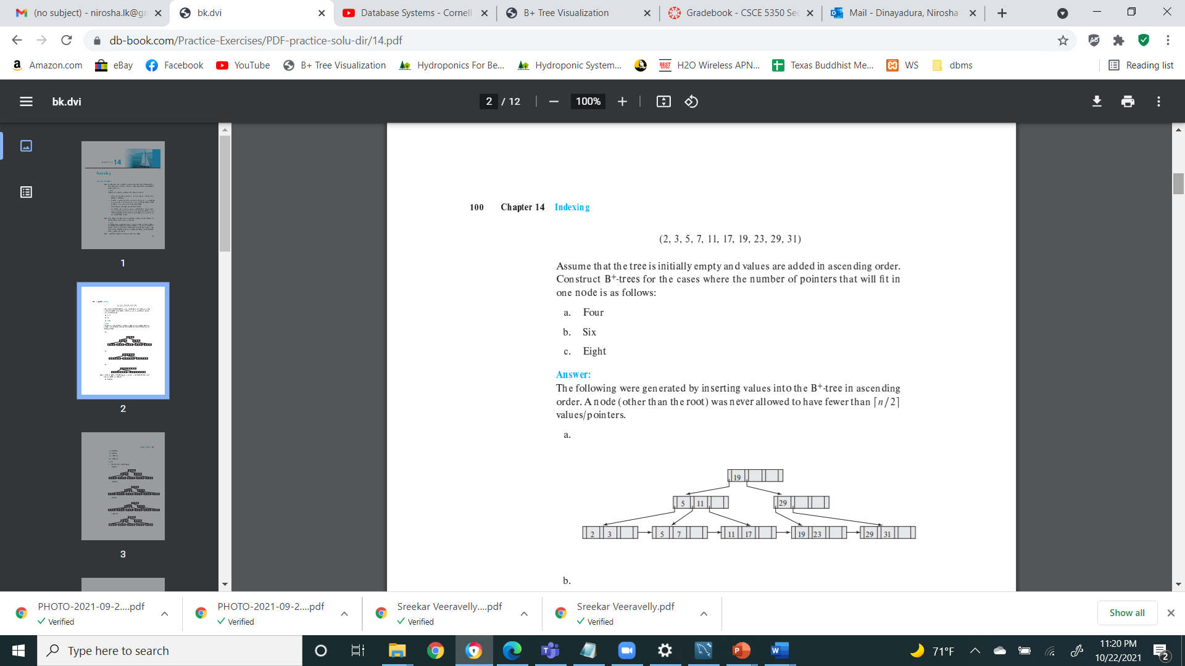
.
2,3,5,7,11,17,19,23,29,31
Notes:
2,3,5,7,11,17,19,23,29,31
https://www.cs.usfca.edu/~galles/visualization/BPlusTree.html

Slide 27
Observations about B⁺-trees
Since the inter-node connections are done by pointers, “logically” close blocks need not be “physically” close.
The non-leaf levels of the B⁺-tree form a hierarchy of sparse indices.
The B⁺-tree contains a relatively small number of levels
Level below root has at least 2* ⎡n/2⎤ values
Next level has at least 2* ⎡n/2⎤ * ⎡n/2⎤ values
.. etc.
If there are K search-key values in the file, the tree height is no more than ⎡ log_{⎡n/2⎤}(K)⎤
thus searches can be conducted efficiently.
Insertions and deletions to the main file can be handled efficiently, as the index can be restructured in logarithmic time (as we shall see).
Notes:
.

Slide 28
Queries on B⁺-Trees
function find(v)
1. C=root
2. while (C is not a leaf node)
Let i be least number s.t. V ≤ K_{i}.
if there is no such number i then
Set C = last non-null pointer in C
else if (v = C.K_{i} ) Set C = P_{i +1}
else set C = C.P_{i}
3. if for some i, K_{i} = V then return C.P_{i}
4. else return null /* no record with search-key value v exists. */

Slide 29
Queries on B⁺-Trees (Cont.)
Range queries find all records with search key values in a given range
See book for details of function findRange(lb, ub) which returns set of all such records
Real implementations usually provide an iterator interface to fetch matching records one at a time, using a next() function

Slide 30
Notes:
2,3,5,7,11,17,19,23,29,31

Slide 31
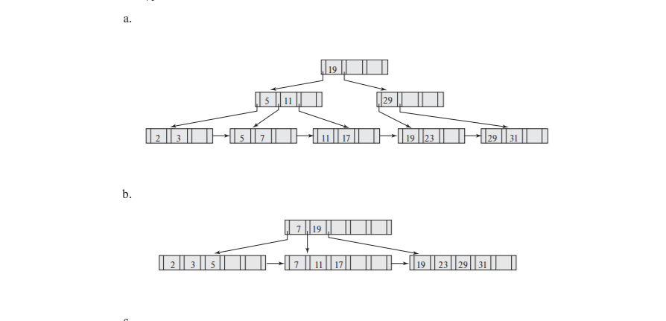
-
-

Slide 32
Queries on B⁺⁻Trees (Cont.)
If there are K search-key values in the file, the height of the tree is no more than ⎡log_{⎡n/2⎤}(K)⎤.
A node is generally the same size as a disk block, typically 4 kilobytes
and n is typically around 100 (40 bytes per index entry).
With 1 million search key values and n = 100
at most log₅₀(1,000,000) = 4 nodes are accessed in a lookup traversal from root to leaf.
Contrast this with a balanced binary tree with 1 million search key values — around 20 nodes are accessed in a lookup
above difference is significant since every node access may need a disk I/O, costing around 20 milliseconds –if each node were in different disk block-disk arm read+block read= 10 milliseconds
Notes:
Search key – 12 bytes pointer 8 bytes
B+ fat and short

Slide 33
Non-Unique Keys
If a search key a_{i} is not unique, create instead an index on a composite key (a_{i} , A_{p}), which is unique
A_{p} could be a primary key, record ID, or any other attribute that guarantees uniqueness
Search for a_{i} = v can be implemented by a range search on composite key, with range (v, - ∞) to (v, + ∞)
But more I/O operations are needed to fetch the actual records
If the index is clustering, all accesses are sequential
If the index is non-clustering, each record access may need an I/O operation

Slide 34
Updates on B⁺-Trees: Insertion
Assume record already added to the file. Let
pr be pointer to the record, and let
v be the search key value of the record
Find the leaf node in which the search-key value would appear
If there is room in the leaf node, insert (v, pr) pair in the leaf node
Otherwise, split the node (along with the new (v, pr) entry) as discussed in the next slide, and propagate updates to parent nodes.

Slide 35
Updates on B⁺-Trees: Insertion (Cont.)
Splitting a leaf node:
take the n (search-key value, pointer) pairs (including the one being inserted) in sorted order. Place the first ⎡n/2⎤ in the original node, and the rest in a new node.
let the new node be p, and let k be the least key value in p. Insert (k,p) in the parent of the node being split.
If the parent is full, split it and propagate the split further up.
Splitting of nodes proceeds upwards till a node that is not full is found.
In the worst case the root node may be split increasing the height of the tree by 1.
Result of splitting node containing Brandt, Califieri and Crick on inserting Adams
Next step: insert entry with (Califieri, pointer-to-new-node) into parent

Slide 36
B⁺-Tree Insertion
Splitting leaf node
Affected nodes
B⁺-Tree before and after insertion of “Adams”
Notes:
https://www.cs.usfca.edu/~galles/visualization/BPlusTree.html
Brandit Califeri Crick Einstein El Gold Katz Kim Mozart Singh Sri Wu

Slide 37
B⁺-Tree Insertion
Splitting non-leaf node
B⁺-Tree before and after insertion of “Lamport”
Affected nodes
Affected nodes

Slide 38
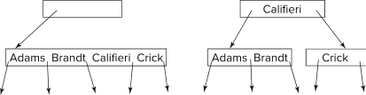
Insertion in B⁺-Trees (Cont.)
Splitting a non-leaf node: when inserting (k,p) into an already full internal node N
Copy N to an in-memory area M with space for n+1 pointers and n keys
Insert (k,p) into M
Copy P₁,K₁, …, K _{⎡n/2⎤-1},P _{⎡n/2⎤} from M back into node N
Copy P_{⎡n/2⎤+1},K _{⎡n/2⎤+1},…,K_{n},P_{n+1} from M into newly allocated node N'
Insert (K _{⎡n/2⎤},N') into parent N
Example
Read pseudocode in book!

Slide 39
Examples of B⁺-Tree Deletion
Before and after deleting “Srinivasan”
Affected nodes
Deleting “Srinivasan” causes merging of under-full leaves
Notes:
Locate siri
Delete entry
Wu is left with one element
Mearge with sibling or redistribute entries between nodes ensure each node is half full.
Here merged with left sibling node
6 empty right sibling is deleted.
Once node is deleted,we must also delete entry in the parent node that pointed to the just deleted node. Eg- sri ,n3

Slide 40
Examples of B⁺-Tree Deletion (Cont.)
Before and after deleting “Singh” and “Wu”
Affected nodes
Leaf containing Singh and Wu became underfull, and borrowed a value Kim from its left sibling
Search-key value in the parent changes as a result
Notes:
Deletion of second value node become underful.
It is not possible to merge the underfull node with its siblings so redistribution
Moving the search key value kim in to the node containing mozart

Slide 41
Example of B⁺-tree Deletion (Cont.)
Before and after deletion of “Gold”
Node with Gold and Katz became underfull, and was merged with its sibling
Parent node becomes underfull, and is merged with its sibling
Value separating two nodes (at the parent) is pulled down when merging
Root node then has only one child, and is deleted

Slide 42

Updates on B⁺-Trees: Deletion
Assume record already deleted from file. Let V be the search key value of the record, and Pr be the pointer to the record.
Remove (Pr, V) from the leaf node
If the node has too few entries due to the removal, and the entries in the node and a sibling fit into a single node, then merge siblings:
Insert all the search-key values in the two nodes into a single node (the one on the left), and delete the other node.
Delete the pair (K_{i–1}, P_{i}), where P_{i} is the pointer to the deleted node, from its parent, recursively using the above procedure.

Slide 43
Updates on B⁺-Trees: Deletion
Otherwise, if the node has too few entries due to the removal, but the entries in the node and a sibling do not fit into a single node, then redistribute pointers:
Redistribute the pointers between the node and a sibling such that both have more than the minimum number of entries.
Update the corresponding search-key value in the parent of the node.
The node deletions may cascade upwards till a node which has ⎡n/2⎤ or more pointers is found.
If the root node has only one pointer after deletion, it is deleted and the sole child becomes the root.

Slide 44
Complexity of Updates
Cost (in terms of number of I/O operations) of insertion and deletion of a single entry proportional to height of the tree
With K entries and maximum fanout of n, worst case complexity of insert/delete of an entry is O(log_{⎡n/2⎤}(K))
In practice, number of I/O operations is less:
Internal nodes tend to be in buffer
Splits/merges are rare, most insert/delete operations only affect a leaf node
Average node occupancy depends on insertion order
2/3rds with random, ½ with insertion in sorted order

Slide 45
Non-Unique Search Keys
Alternatives to scheme described earlier
Buckets on separate block (bad idea)
List of tuple pointers with each key
Extra code to handle long lists
Deletion of a tuple can be expensive if there are many duplicates on search key (why?)
Worst case complexity may be linear!
Low space overhead, no extra cost for queries
Make search key unique by adding a record-identifier-composite
Extra storage overhead for keys
Simpler code for insertion/deletion
Widely used
Notes:
45

Slide 46
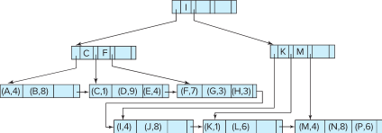
B⁺-Tree File Organization
Extensions and variations of B+ tree
B⁺-Tree File Organization:
Leaf nodes in a B⁺-tree file organization store records, instead of pointers
Helps keep data records clustered even when there are insertions/deletions/updates
Leaf nodes are still required to be half full
Since records are larger than pointers, the maximum number of records that can be stored in a leaf node is less than the number of pointers in a nonleaf node.
Insertion and deletion are handled in the same way as insertion and deletion of entries in a B⁺-tree index.

Slide 47
B⁺-Tree File Organization (Cont.)
Example of B+-tree File Organization
Good space utilization important since records use more space than pointers.
To improve space utilization, involve more sibling nodes in redistribution during splits and merges
Involving 2 siblings in redistribution (to avoid split / merge where possible) results in each node having at least entries

Slide 48
Other Issues in Indexing
Record relocation and secondary indices
If a record moves, all secondary indices that store record pointers have to be updated
Node splits in B⁺-tree file organizations become very expensive
Solution: use search key of B⁺-tree file organization instead of record pointer in secondary index
Add record-id if B⁺-tree file organization search key is non-unique
Extra traversal of file organization to locate record
Higher cost for queries, but node splits are cheap
Notes:
48

Slide 49
Indexing Strings
Variable length strings as keys
Variable fanout – different node different fan out. string can be long – increased height
Use space utilization as criterion for splitting, not number of pointers
Prefix compression- increase node fanout
Key values at internal nodes can be prefixes of full key
Keep enough characters to distinguish entries in the subtrees separated by the key value
E.g., “Silas” and “Silberschatz” can be separated by “Silb”
Keys in leaf node can be compressed by sharing common prefixes
Notes:
Creating b+ tree indices on string-valued attributes raises two problems. 1. variable length 2. low fanout and tree height -high

Slide 50
Bulk Loading and Bottom-Up Build
Inserting entries one-at-a-time into a B⁺-tree requires ≥ 1 IO per entry-tree height (5)
assuming leaf level does not fit in memory- large relation,non cluster index,large index – 10 millisecond-1 I/O-100 million record read – 1 million second to build the index
can be very inefficient for loading a large number of entries at a time in to a index (bulk loading-index)
Efficient alternative 1:
sort entries first (using efficient external-memory sort algorithms discussed later in Section 12.4)
insert in sorted order
insertion will go to existing page (or cause a split)
much improved IO performance, but most leaf nodes half full
Efficient alternative 2: Bottom-up B⁺-tree construction
As before sort entries
And then create tree layer-by-layer, starting with leaf level
details as an exercise
Implemented as part of bulk-load utility by most database systems

Slide 51
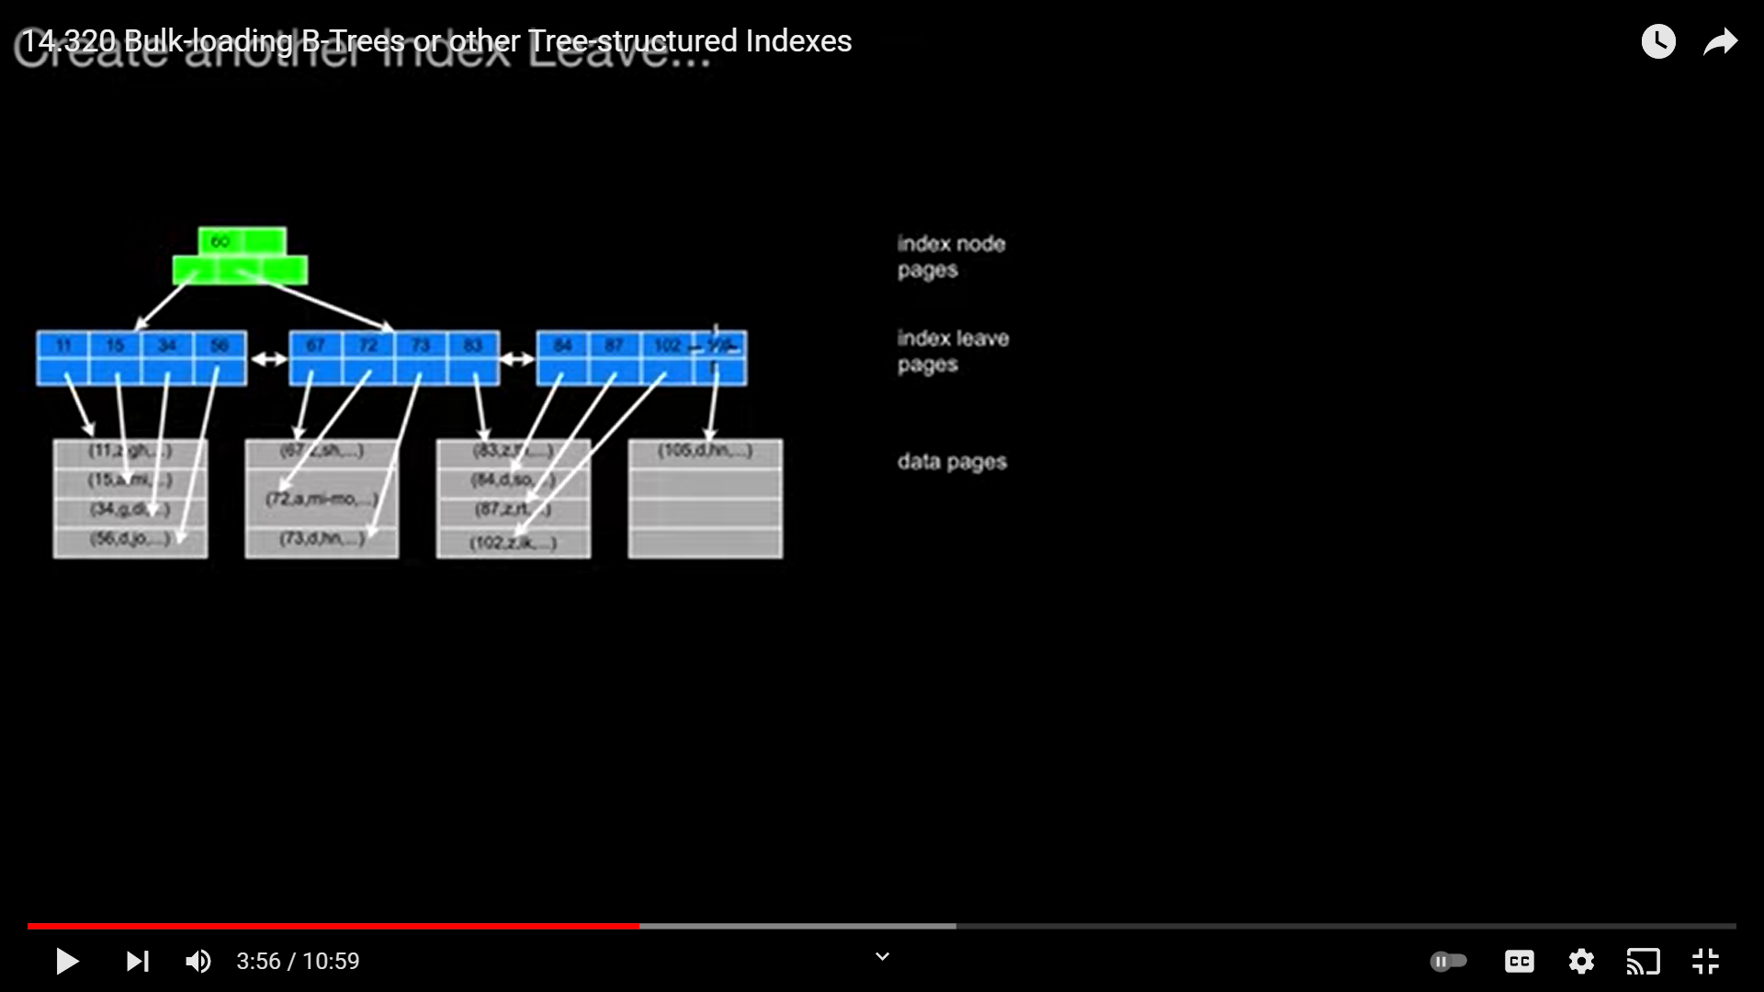
Bulk Loading and Bottom-Up Build

Slide 52
B-Tree Index Files
Similar to B+-tree, but B-tree allows search-key values to appear only once; eliminates redundant storage of search keys.
Search keys in nonleaf nodes appear nowhere else in the B-tree; an additional pointer field for each search key in a nonleaf node must be included.
Generalized B-tree leaf node
Nonleaf node – pointers Bi are the bucket or file record pointers.

Slide 53
B-Tree Index Files (Cont.)
Advantages of B-Tree indices:
May use less tree nodes than a corresponding B⁺-Tree.
Sometimes possible to find search-key value before reaching leaf node.
Disadvantages of B-Tree indices:
Only small fraction of all search-key values are found early
Non-leaf nodes are larger, so fan-out is reduced. Thus, B-Trees typically have greater depth than corresponding B⁺-Tree
Insertion and deletion more complicated than in B⁺-Trees
Implementation is harder than B⁺-Trees.
Typically, advantages of B-Trees do not out weigh disadvantages.

Slide 54
B-Tree Index Files
Similar to B+-tree, but B-tree allows search-key values to appear only once; eliminates redundant storage of search keys.
Search keys in nonleaf nodes appear nowhere else in the B-tree; an additional pointer field for each search key in a nonleaf node must be included.
Generalized B-tree leaf node
Nonleaf node – pointers Bi are the bucket or file record pointers.

Slide 55
B-Tree Index Files (Cont.)
Advantages of B-Tree indices:
May use less tree nodes than a corresponding B⁺-Tree.
Sometimes possible to find search-key value before reaching leaf node.
Disadvantages of B-Tree indices:
Only small fraction of all search-key values are found early
Non-leaf nodes are larger, so fan-out is reduced. Thus, B-Trees typically have greater depth than corresponding B⁺-Tree
Insertion and deletion more complicated than in B⁺-Trees
Implementation is harder than B⁺-Trees.
Typically, advantages of B-Trees do not out weigh disadvantages.

Slide 56
B-Tree Index Files (Cont.)
Advantages of B-Tree indices:
May use less tree nodes than a corresponding B⁺-Tree.
Sometimes possible to find search-key value before reaching leaf node.
Disadvantages of B-Tree indices:
Only small fraction of all search-key values are found early
Non-leaf nodes are larger, so fan-out is reduced. Thus, B-Trees typically have greater depth than corresponding B⁺-Tree
Insertion and deletion more complicated than in B⁺-Trees
Implementation is harder than B⁺-Trees.
Typically, advantages of B-Trees do not out weigh disadvantages.

Slide 57


B-Tree Index File Example
B-tree (above) and B+-tree (below) on same data

Slide 58
Indexing on Flash
Random I/O cost much lower on flash
20 to 100 microseconds for read/write
Writes are not in-place, and (eventually) require a more expensive erase
Optimum page size therefore much smaller
Bulk-loading still useful since it minimizes page erases
Write-optimized tree structures (discussed later) have been adapted to minimize page writes for flash-optimized search trees –bottom up construction.

Slide 59
Indexing in Main Memory
Random access in memory
Much cheaper than on disk/flash
But still expensive compared to cache read
Data structures that make best use of cache preferable
Binary search for a key value within a large B⁺-tree node results in many cache misses
B⁺- trees with small nodes that fit in cache line are preferable to reduce cache misses
Key idea: use large node size to optimize disk access, but structure data within a node using a tree with small node size, instead of using an array.

Slide 60
Hashing

Slide 61
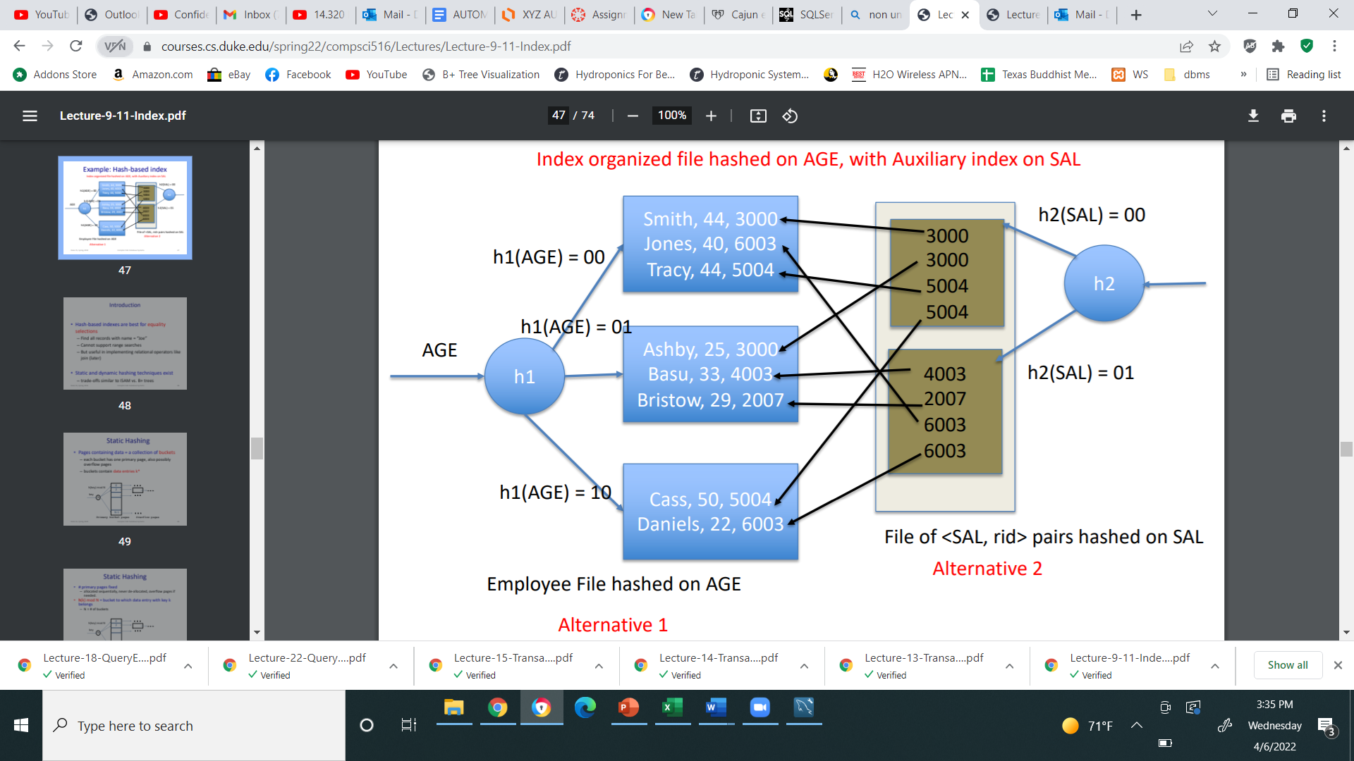
Static Hashing
A bucket is a unit of storage containing one or more entries (a bucket is typically a disk block).
we obtain the bucket of an entry from its search-key value using a hash function
Hash function h is a function from the set of all search-key values K to the set of all bucket addresses B.
Hash function is used to locate entries for access, insertion as well as deletion.
Entries with different search-key values may be mapped to the same bucket; thus entire bucket has to be searched sequentially to locate an entry.
In a hash index, buckets store entries with pointers to records
In a hash file-organization buckets store records
Technique for building indices in main memory.
Used to organize records in file – rare
In-memory hashing, disk-based hashing

Slide 62
Handling of Bucket Overflows
Bucket overflow can occur because of
Insufficient buckets
Skew in distribution of records. This can occur due to two reasons:
multiple records have same search-key value
chosen hash function produces non-uniform distribution of key values
Although the probability of bucket overflow can be reduced, it cannot be eliminated; it is handled by using overflow buckets.

Slide 63
Handling of Bucket Overflows (Cont.)
Overflow chaining – the overflow buckets of a given bucket are chained together in a linked list.
Above scheme is called closed addressing (also called closed hashing or open hashing depending on the book you use)
An alternative, called open addressing (also called open hashing or closed hashing depending on the book you use) which does not use over- flow buckets, is not suitable for database applications.

Slide 64
Example of Hash File Organization
Hash file organization of instructor file, using dept_name as key (See figure in next slide.)
There are 10 buckets,
The binary representation of the I ^{th} character is assumed to be the integer i.
The hash function returns the sum of the binary representations of the characters modulo 10
E.g. h(Music) = 1 h(History) = 2 h(Physics) = 3 h(Elec. Eng.) = 3
ASCI values of characters in dept. eg : a=65

Slide 65
Example of Hash File Organization
Hash file organization of instructor file, using dept_name as key (See figure in next slide.)
There are 10 buckets,
The binary representation of the I ^{th} character is assumed to be the integer i.
The hash function returns the sum of the binary representations of the characters modulo 10
E.g. h(Music) = 1 h(History) = 2 h(Physics) = 3 h(Elec. Eng.) = 3

Slide 66
Example of Hash File Organization
Hash file organization of instructor file, using dept_name as key.

Slide 67
Deficiencies of Static Hashing
In static hashing, function h maps search-key values to a fixed set of B of bucket addresses. Databases grow or shrink with time.
If initial number of buckets is too small, and file grows, performance will degrade due to too much overflows.
If space is allocated for anticipated growth, a significant amount of space will be wasted initially (and buckets will be underfull).
If database shrinks, again space will be wasted.
One solution: periodic re-organization of the file with a new hash function
Expensive, disrupts normal operations
Better solution: allow the number of buckets to be modified dynamically.

Slide 68
Creation of Indices
Example create index takes_pk on takes (ID,course_ID, year, semester, section) drop index takes_pk
Most database systems allow specification of type of index, and clustering.
Indices on primary key created automatically by all databases
Why?
Some database also create indices on foreign key attributes
Why might such an index be useful for this query:
takes ⨝ σ_{name='Shankar'} (student)
Indices can greatly speed up lookups, but impose cost on updates
Index tuning assistants/wizards supported on several databases to help choose indices, based on query and update workload

Slide 69
Index Definition in SQL
Create an index
create index <index-name> on <relation-name> (<attribute-list>)
E.g.,: create index b-index on branch(branch_name)
Use create unique index to indirectly specify and enforce the condition that the search key is a candidate key.
Not really required if SQL unique integrity constraint is supported
To drop an index
drop index <index-name>
Most database systems allow specification of type of index, and clustering.

Slide 70
Spatial and Temporal Indices
-Techniques for indexing special data
-point or a region in two or higher diamentional space

Slide 71
Spatial Data
Databases can store data types such as lines, polygons, in addition to raster images
allows relational databases to store and retrieve spatial information
Queries can use spatial conditions (e.g. contains or overlaps).
queries can mix spatial and nonspatial conditions
Nearest neighbor queries, given a point or an object, find the nearest object that satisfies given conditions.
Range queries deal with spatial regions. e.g., ask for objects that lie partially or fully inside a specified region.
Queries that compute intersections or unions of regions.
Spatial join of two spatial relations with the location playing the role of join attribute.
B+index - restaurant at precise long,lat
Notes:
Query can answer B+index - restaurant at precise long laty - composite atrib good but restaurant within 500m radius of user location or in a rectangular area ? – range queries
Nearest neighbor queries – ex-ask for the nearest restaurant to a specified location
The goal of special indexing is to support different forms of special queries, with range and nearest neighbor queries being of particular interest,since they are widely used.

Slide 72


Indexing of Spatial Data
k-d tree - early structure used for indexing in multiple dimensions.
Each level of a k-d tree partitions the space into two.
Choose one dimension for partitioning at the root level of the tree.
Choose another dimensions for partitioning in nodes at the next level and so on, cycling through the dimensions.
In each node, approximately half of the points stored in the sub-tree fall on one side and half on the other.
Partitioning stops when a node has less than a given number of points.
The k-d-B tree extends the k-d tree to allow multiple child nodes for each internal node; well-suited for secondary storage.
Notes:
Rectangular range queries, which ask for points within a specified rectangular region, can be answered efficiently using k-d tree
Ex- range query may ask all points x diamention lie between 50 and 80 , y 40 and 70.

Slide 73
Division of Space by Quadtrees
Each node of a quadtree is associated with a rectangular region of space; the top node is associated with the entire target space.
Each non-leaf nodes divides its region into four equal sized quadrants
correspondingly each such node has four child nodes corresponding to the four quadrants and so on
Leaf nodes have between zero and some fixed maximum number of points (set to 1 in example).
alternative index structures for special data
alternative index structures for special data.
Notes:
There are no. of alternative index structures for special data.
Quadtree divide up a two-d space in to 4 quadrant at each node of the tree.

Slide 74
R-Trees
R-trees are a N-dimensional extension of B⁺-trees, useful for indexing sets of rectangles and other polygons.
Supported in many modern database systems, along with variants like R⁺ -trees and R*-trees.
Basic idea: generalize the notion of a one-dimensional interval associated with each B+ -tree node to an N-dimensional interval, that is, an N-dimensional rectangle.
Will consider only the two-dimensional case (N = 2)
generalization for N > 2 is straightforward, although R-trees work well only for relatively small N
The bounding box of a node is a minimum sized rectangle that contains all the rectangles/polygons associated with the node
Bounding boxes of children of a node are allowed to overlap

Slide 75
Example R-Tree
A set of rectangles (solid line) and the bounding boxes (dashed line) of the nodes of an R-tree for the rectangles.
The R-tree is shown on the right.
Bbi –coordinates of bounding box i.
Notes:
Bb –coordinates of bounding box i.
One copy of each object is stored.

